Slide 1

Wireless Networks and MOBILE Computing
BY Mr. VALENS NSENGIYUMVA
Communication Systems Engineer, Sweden
Telephone: 0787288628
Email: nvalens18@gmail.com

Slide 2
DAY 3: Two- Ray (Grounded Reflection) Model
Direct Path, Reflected Path, Total Two-Ray E-Field
Reflection,
Diffraction
DAY 4: Cellular Large Scale Path Loss Models, Link budgeting , Diffraction, Rough Surface Scattering
Okumura- Hata Models, Link Budget Procedure, Thermal noise, Examples

Slide 3
7. Reflection AND TRANSMISSION
Reflection
Reflection of light is an everyday occurrence. Mirrors are commonplace and can be seen in houses and many other places. Shop windows also provide another illustration for this phenomenon, as do many other areas. Radio waves are similarly reflected by many surfaces.
When reflection occurs, it can be seen that the angle of incidence is equal to the angle of reflection for a conducting surface as would be expected for light. When a signal is reflected there is normally some loss of the signal, either through absorption, or as a result of some of the signal passing into the medium.
A variety of surfaces can reflect radio signals. For long distance communications, the sea provides one of the best reflecting surfaces. Other wet areas provide good reflection of radio signals. Desert areas are poor reflectors and other types of land fall in between these two extremes. In general, though, wet areas provide better reflectors.
For relatively short range communications, many buildings, especially those with metallic surfaces provide excellent reflectors of radio energy. There are also many other metallic structures such as warehouses that give excellent reflecting surfaces. As a result of this signals travelling to and from cellular phones often travel via a variety of paths. Similar effects are noticed for Wi-Fi and other short range wireless communications. An office environment contains many surfaces that reflect radio signals very effectively.

Slide 4
8. Two-Ray (grounded REFLECTION) Model: Direct Path and reflected path
The Two-Rays Ground Reflected Model is a radio propagation model which predicts the path losses between a transmitting antenna and a receiving antenna when they are in LOS (line of sight) .
Generally, the two antenna each have different height. The received signal having two components, the LOS component and the multipath component formed predominantly by a single ground reflected wave.

Slide 5
Power and Distance Characteristics
When the distance d between antennas is less than the transmitting antenna height, two Ray waves are added constructively to yield bigger power.
As the distance increases, these waves add up constructively and destructively, giving regions of up-fade and down-fade.
As the distance increases beyond the critical distance dc, the power drops proportionally to an inverse of the fourth of the power of d, which means 1/d^4.

Slide 6
9. Cellular Large Scale Path Loss Models
9.1. Okumura- Hata Model

Slide 7
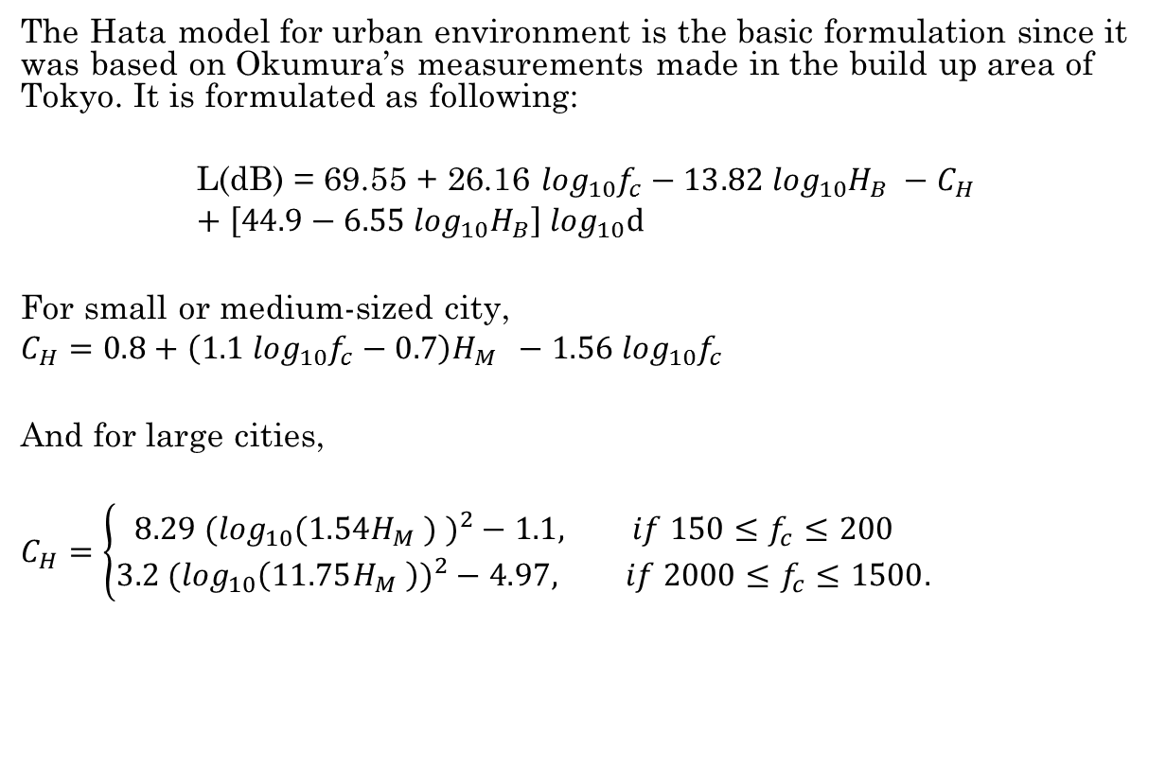
9.1. Okumura-Hata Model for urban environment
The Hata model for urban environment is the basic formulation since it was based on Okumura’s measurements made in the build up area of Tokyo. It is formulated as following:
$$\text{L}\text{(}\text{dB}\text{) = 69.55 + 26.16 }\log_{10}f_{c}−13.82 {\log_{10}H}_{B} −C_{H}+\left[44.9−6.55\log_{10}H_{B}\right]\log_{10}d$$
For small or medium-sized city,
$$C_{H}=0.8+\left(1.1 \log_{10}f_{c}−0.7\right){H_{M } −1.56 log}_{10}f_{c}$$
And for large cities,
$$C_{H}=\left\{\begin{aligned}8.29 (\log_{10}(1.54H_{M} ) )^{2}−1.1, if 150≤f_{c}≤200 \\ 3.2 (\log_{10}\left(11.75H_{M} \right))^{2}−4.97, if 2000≤f_{c}≤1500.\end{aligned}\right.$$

Slide 8
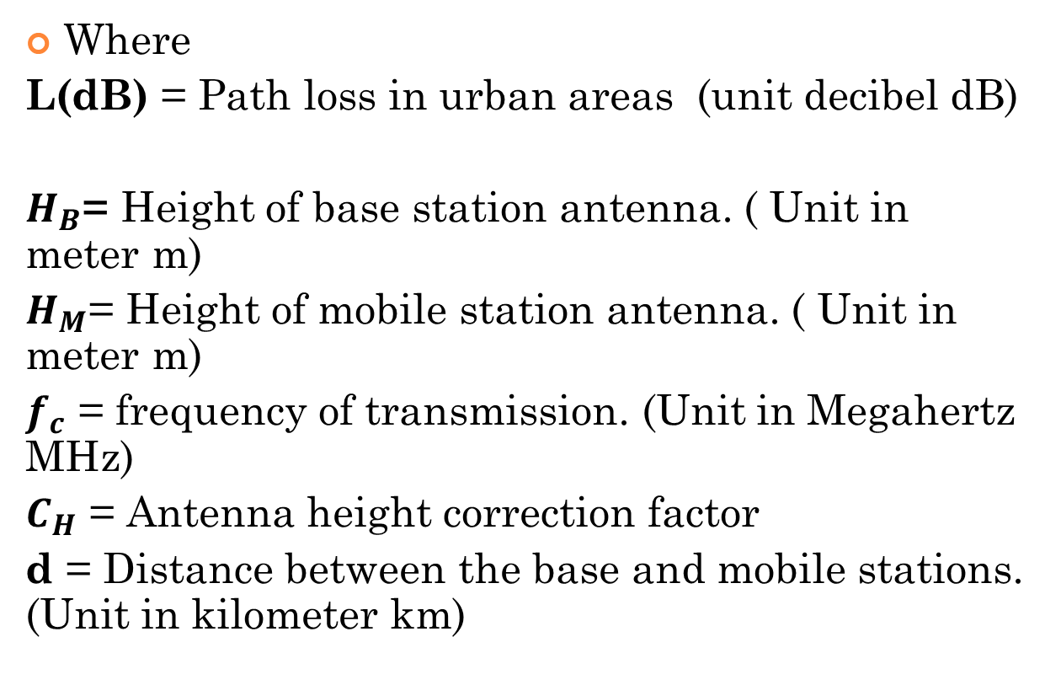
9.1.
Where
$\text{L}\text{(}\text{dB}\text{)}$ = Path loss in urban areas (unit decibel dB)
$H_{B}$= Height of base station antenna. ( Unit in meter m)
$H_{M}$= Height of mobile station antenna. ( Unit in meter m)
$f_{c}$ = frequency of transmission. (Unit in Megahertz MHz)
$C_{H}$ = Antenna height correction factor
d = Distance between the base and mobile stations. (Unit in kilometer km)

Slide 9
11. Link budget

Slide 10
11.1. Link Budget procedure

Slide 11
11.1

Slide 12
11.2 THERMAL NOISE

Slide 13
11.2.

Slide 14
In this example the Antenna height correction factor is ignored which is not always applicable.

Slide 15
12. Diffraction
Radio signals may also undergo diffraction. It is found that when signals encounter an obstacle they tend to travel around them. This can mean that a signal may be received from a transmitter even though it may be "shaded" by a large object between them.
This is particularly noticeable on some long wave broadcast transmissions. the signal will diffract around the obstacle and start to fill the void.
It is found that diffraction is more pronounced when the obstacle becomes sharper and more like a "knife edge". For a radio signal a mountain ridge may provide a sufficiently sharp edge. A more rounded hill will not produce such a marked effect.
It is also found that low frequency signals diffract more markedly than higher frequency ones. It is for this reason that signals on the long wave band are able to provide coverage even in hilly or mountainous terrain where signals at VHF and higher would not.

Slide 16
13. Rough surface scattering

Slide 17
14. Multipath fading

Slide 18
15. Fade distribution
15.1. Rayleigh distribution

Slide 19
15.1.

Slide 20
15.1 Example

Slide 21
END OF DAY 3
THANK YOU

